Slide 1
Assembly Programming
Vs
Object Oriented Programming
Chris Rudel
Katie Prescott
Josh Garner

Slide 2
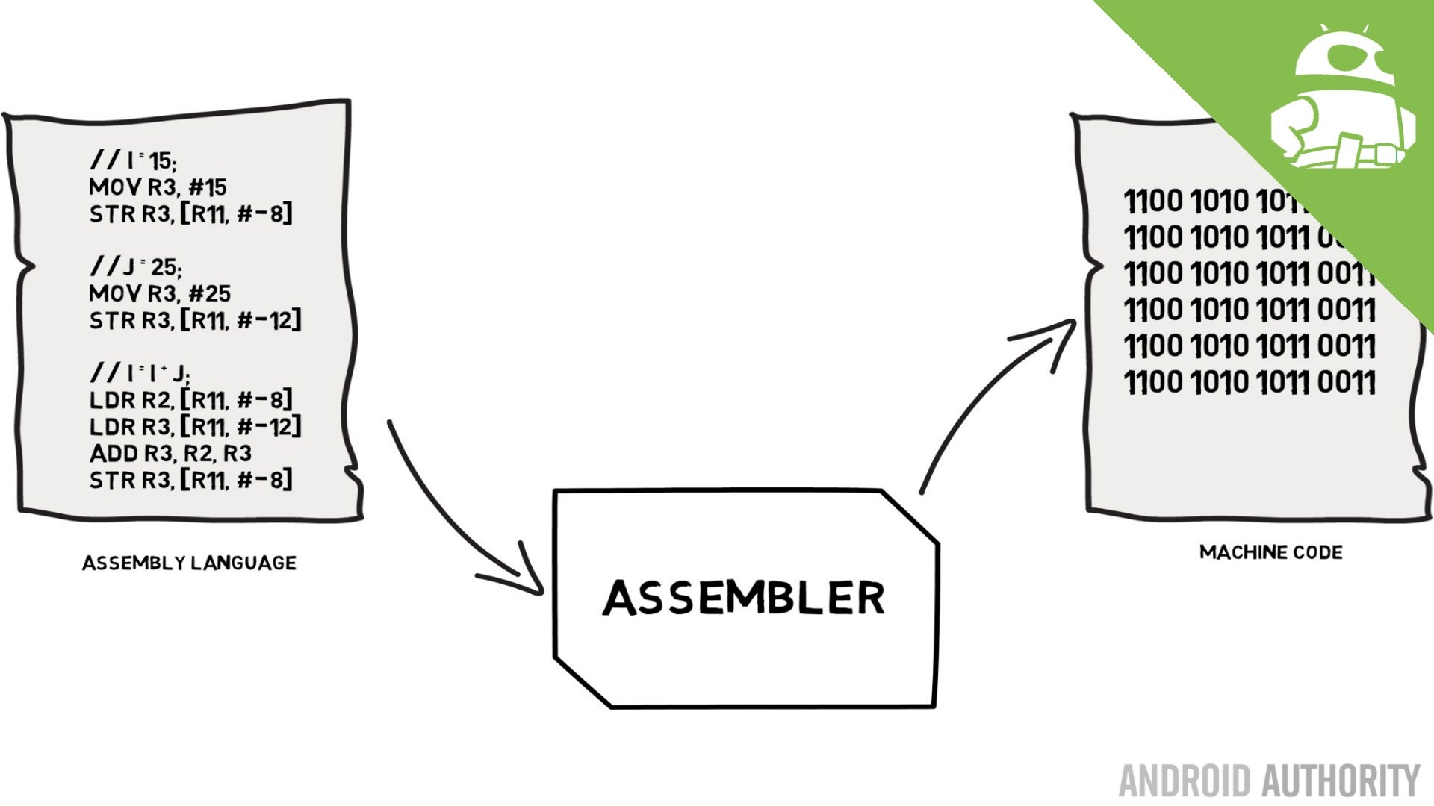
What is Assembly Programming
Low level programming language for a programmable device where there is a strong relationship between the language and the architecture’s machine code instructions
Assembly code is converted to executable machine code by using a utility program known as the assembler
Most assembly languages are designed with 3 different types of statement operations such as
Data definitions
Assembly directives
Opcode mnemonics
Notes:
Josh

Slide 3
What is Assembly Programming
4 Main types of assembly language
CISC: Complex Instruction-Set Computer
First Assembly language developed
Complicated, Often with specialized instructions, many complicated address modes
So complicated, only used for small programs (microcode)
RISC: Reduced Instruction-Set Computer
Response to growing use of compilers
Easier to target, uniform instruction set
Load store architecture
Designed to be pipelined
Notes:
Josh

Slide 4
What is Assembly Programming
4 Main types of assembly language
DSP: Digital Signal Processor
Digital signal processors designed for signal processing algorithms
Irregular architectures to save power, space
Substantial instruction - level parallelism
VLIW: Very Long Instruction Word
Response to growing desire for instruction level parallelism
Uses more transistors, cheaper than running them faster
Many Parallel ALUs
Designed to keep everything busy all the time
Notes:
Josh

Slide 5
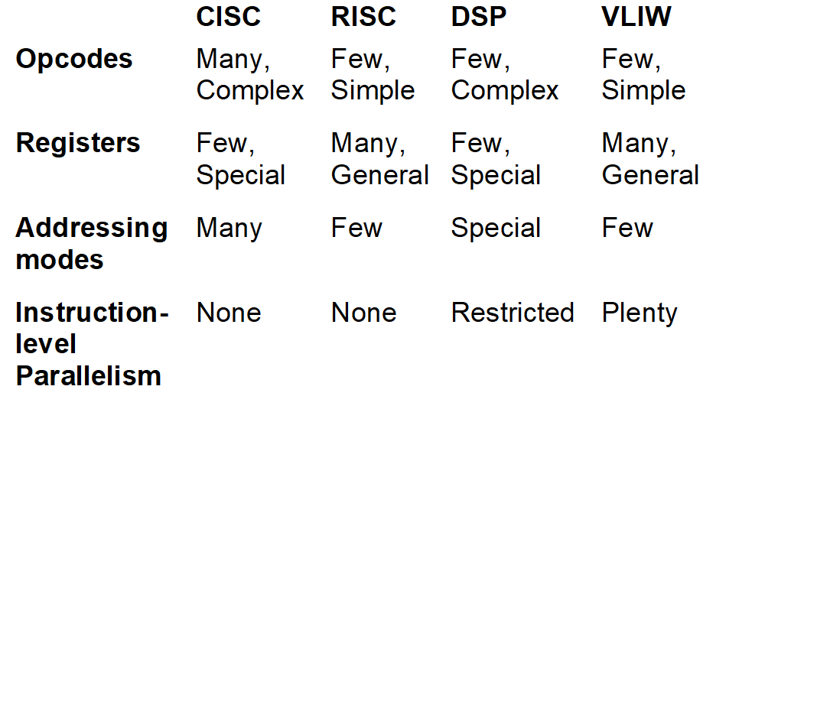

Types of Assembly Languages
Notes:
Josh

Slide 6



What is Object Oriented Programming
Object Oriented programming is programming based on the concept of “objects” which contain data AKA attributes. The data within the objects are able to be modified, and code is largely objects interacting with one another. Many popular OOP languages use class based objects, meaning objects are instances of classes.
Notes:
Katie

Slide 7
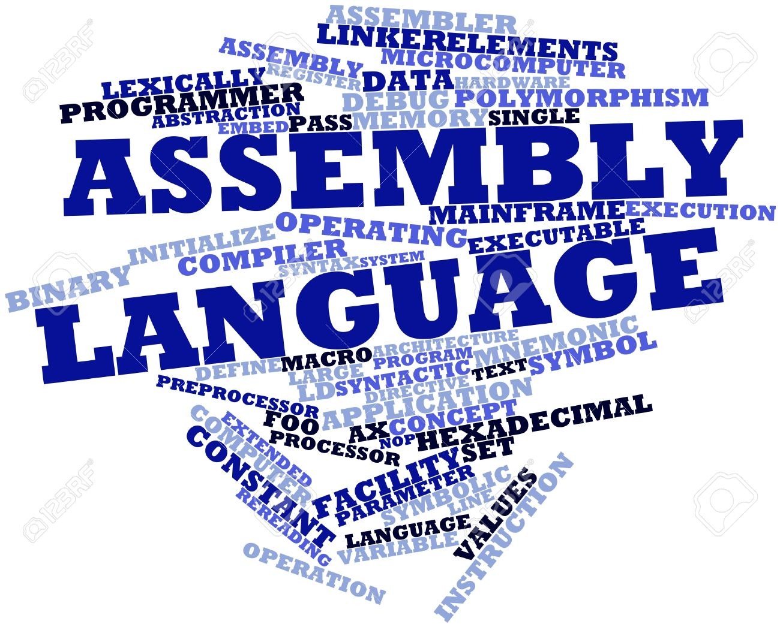
Advantages of Assembly
Easy access to registers and I/O devices
Control code behavior between multiple software threads and hardware devices
You can optimize your code for your specific hardware setup
Access unusual programming modes of your processor (16 bit mode to interface startup, firmware, or legacy code on Intel PCs)
Change the normal conventions of your compiler for optimization purposes
Notes:
Chris

Slide 8
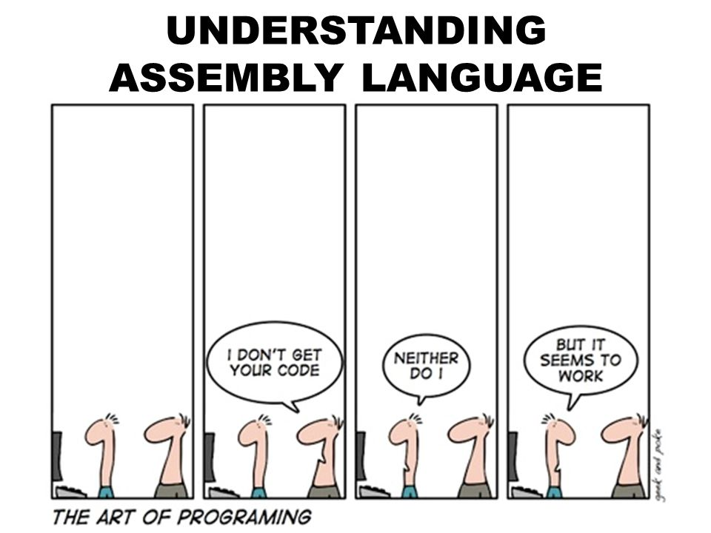
Disadvantages of Assembly
Assembly programming can be difficult without the help of comments which can hinder debugging
Code can be long and tedious to write
Code written for a particular architecture can be optimized on one machine but can be slow for another machine or break all together
Small changes in algorithm designs for performance can break code and entire blocks of code will need to be rewritten
Notes:
Chris

Slide 9
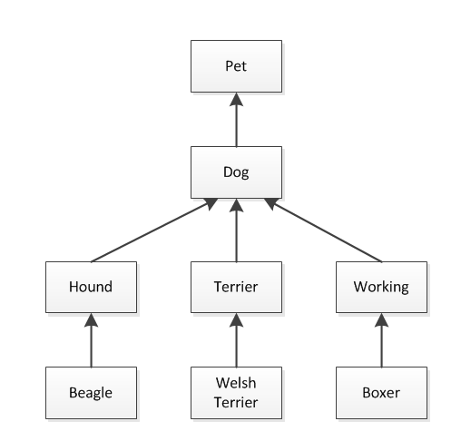
Advantages of Object Oriented
Object Oriented Programming is very readable and understandable.
The code reads like a set of instructions, similar to what a computer would read.
Scalable code - You can use subclasses and parent classes, which makes it easier to develop new code.
Code is reusable (encapsulation), meaning it can be reused in other projects without having to modify much of the code.
Notes:
Katie

Slide 10
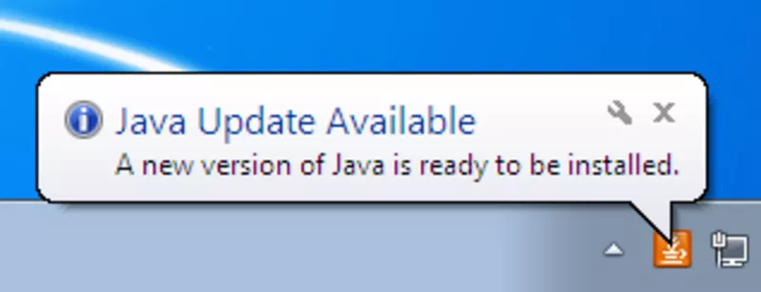
Disadvantages of Object Oriented
Criticized for overemphasizing modeling data (objects) over other important aspects like algorithms
Requires a lot of planning to write efficient and complete code.
Larger program sizes due to more lines of code
OO programs are typically slower than procedure based programs since they require more instructions to be executed
Stuff like this
Notes:
Katie

Slide 11
Current Uses of Assembly
Still used for mainframes and terminals
Projects run on small architectures such as arduinos
Programs that rely on real time such as flight simulations and medical equipment- delays are minimized by lack of interpreters and garbage collection
Device Drivers - Act as a translator between hardware and applications or operating systems
ROM Hacking - editing text and other data for a video game which can modify levels or maps
Notes:
Chris

Slide 12

Current Uses of Object Oriented Programming
Android Apps - many apps on android phones are written in Java
Server Applications for Financial Services - Financial companies will design server side applications with object oriented programing languages
Trading Applications - Popular trading application like Murex, which is used in many banks for front to bank connectivity, is also written in Python with Object Oriented attributes
Big Data Technologies - HBase, Accumulo, and Elasticsearch are all written in Java.
Notes:
Chris

Slide 13
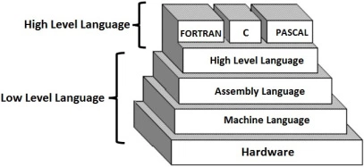
Future Of Assembly
Programming
“Assembly language continues to hold a core position in the programming world because of its similar structure to machine language and its close links to underlying computer-processor architecture and design. These features allow for high processing speed, low memory demands and the capacity to act directly on the system’s hardware.” –Sivarama Dandamudi
Notes:
Josh

Slide 14
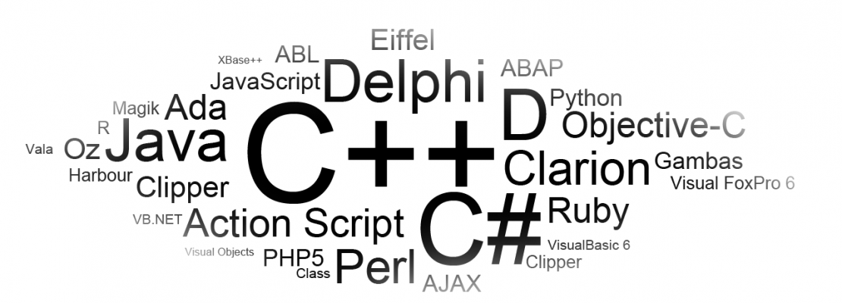
Future of Object Oriented Programming
There are many people who believe that the future of Object Oriented Programming is bleak. Many believe that there are many better options, (like functional programming)
On the other hand, many people also believe that Object Oriented Programming languages will continue to dominate among computer programming languages.
Notes:
Katie
Functional programming -> a lot of object oriented features are being added to functional programming.

Slide 15
Any Questions?

